Slide 1
Foundations of Organizational Behavior
Learning outcome-
to understand OB Model and Contributing disciplines of OB

Slide 2
OB
Organizational Behavior (OB) is the systematic study of the actions and attitudes that people exhibit within Organizations.
It is individual behavior and group dynamics in Organizations.
The study of Organizational behavior is primarily concerned with the psychosocial, interpersonal and behavioral dynamics in organizations.

Slide 3
The nature of organizational behavior
Organizational behavior is neither a purely scientific area of inquiry nor a strictly intellectual endeavor.
It involves the study of abstract ideas, such as valance and expectancy in motivation, as well as the study of concrete matters, such as observable behaviors and physiological symptoms of distress at work.

Slide 4
Determinants of organizational behavior
Human behavior
Organizational context
Organizational context includes------
1. Organizations as systems and
2. The formal and informal organizations.

Slide 5
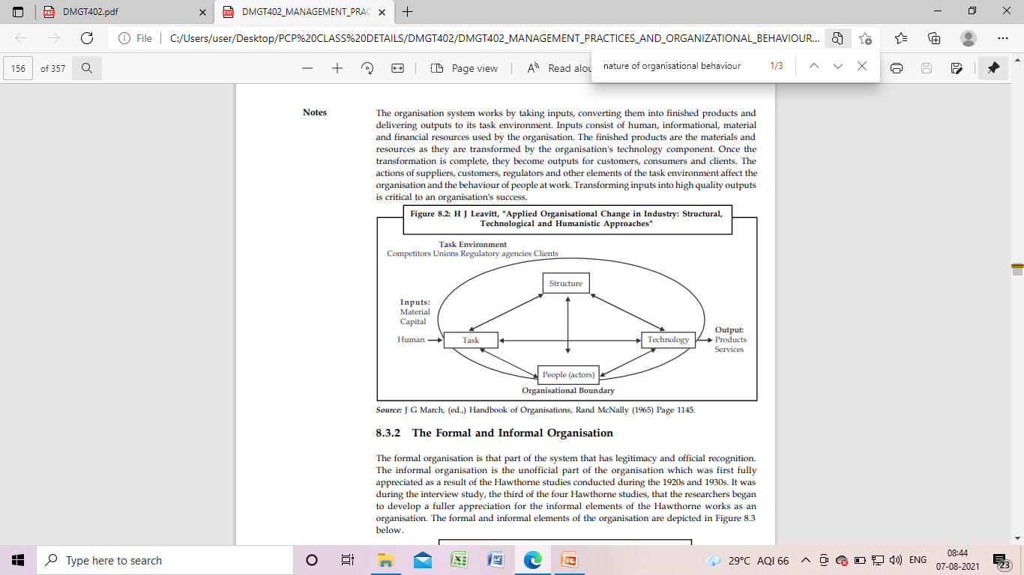
Organizations as Systems
Organizations are systems of interacting components which are people, tasks, technology and structure.

Slide 6
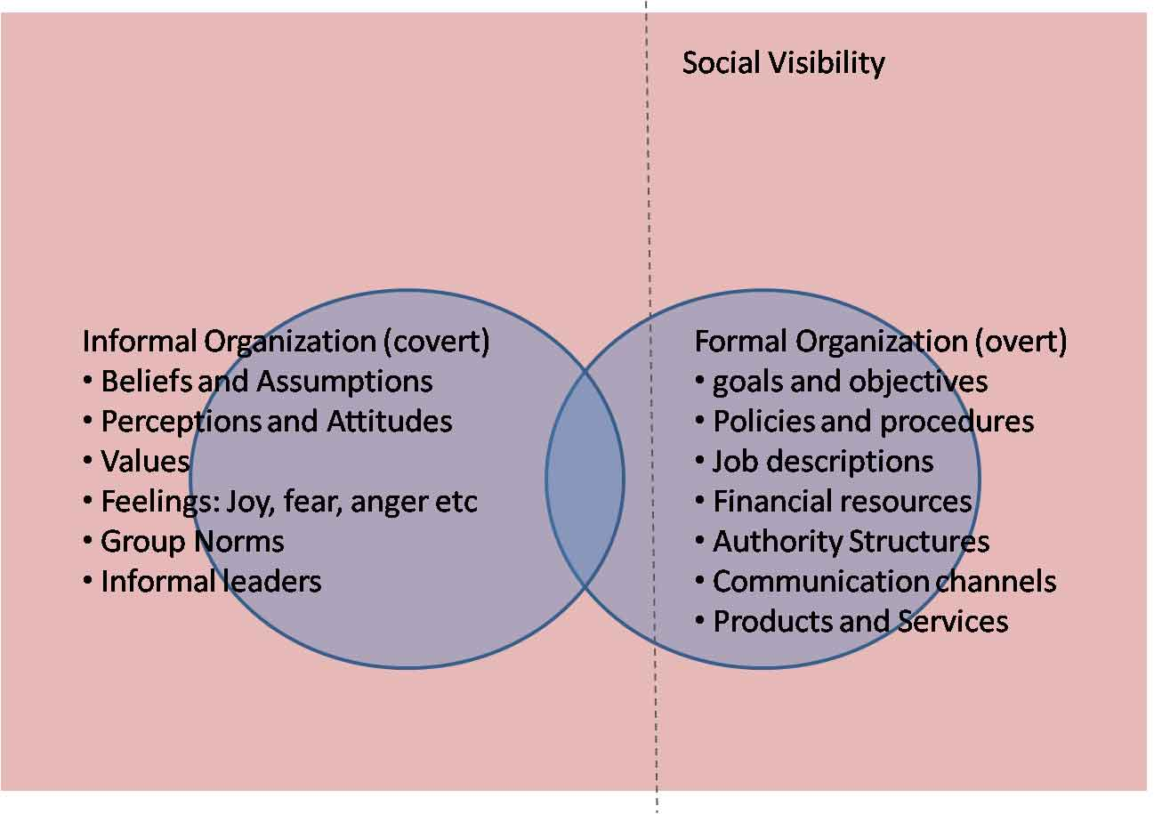
The Formal and Informal Organization
The formal organization is that part of the system that has legitimacy and official recognition. The informal organization is the unofficial part of the organization.

Slide 7
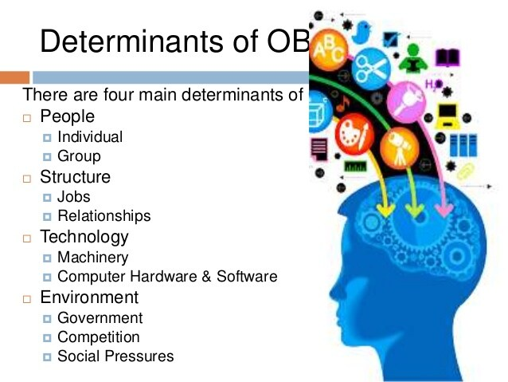

Slide 8
Need for Organizational Behavior
1. Explain individual and group behavior. We are pursuing the explanation objective when we want to know why individuals or groups behave the way they do.
2. Predict certain behavioral response to change. Having a sound knowledge of OB will help the manager to predict certain behavioral responses to change.

Slide 9
……………..
3. Control Behavior. The knowledge of OB can be used by managers to control behavior. Managers frequently see the control objective as the most valuable contribution that OB makes toward their effectiveness on the job.

Slide 10
Contributing Disciplines

Slide 11
Quiz
Organizational Behavior is the study of _____________ in the organization
A. Human
B. Employer
C. Human Behavior
D. Employees

Slide 12
Quiz
Which of the following is not a force affecting organizational behavior are _______
a) People
b) Environment
c) Technology
d) Industry competition

Slide 13
Contributing Disciplines of OB
Psychology
Sociology
Social-psychology
Anthropology

Slide 14
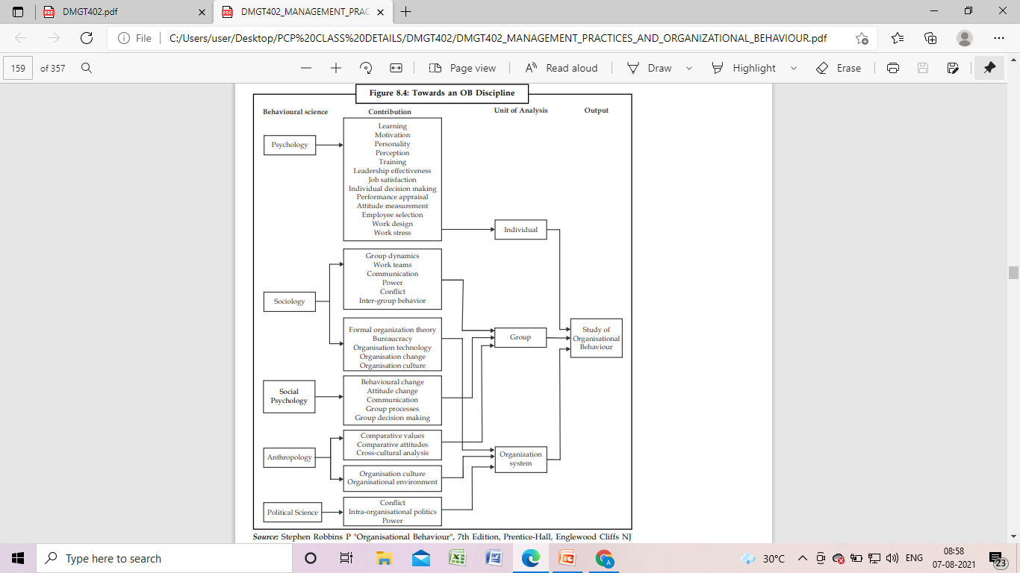
……….

Slide 15
Organisational Behaviour Models
Model is an abstraction of reality
Developed to guide activities in different fields
In OB, Models provide framework about How people will be treated in an organisation.

Slide 16
Factors: Independent and Dependent variables
Personality
Leadership
Perception
Learning
Values
Emotional Intelligence
Motivation
Team
Power
Politics
Culture
Employee Performance
Productivity
Absenteeism
Job Satisfaction

Slide 17
OB Model
The five models of organizational behavior are the:
autocratic model,
custodial model,
supportive model,
collegial model and
system model.

Slide 18
OB Model
Autocratic Model:
Managerial orientation is towards power
Managers see authority as the only means to get work done
Employees are expected to follow orders
High dependent on boss
Largely based on Theory X assumptions of Mcgregor
A very strict and close supervision is required
Communication is mostly Downward
Performance is ensured through fear, threats, punishments and occasional rewards.

Slide 19
OB Model
Custodian Model:
Managerial orientation is towards the use of Money
Model dependents on the economic resources
Employee obtain security (Herzberg’s theory, only maintenance factor).
Highly dependent on organisation
Less dependent on boss
Level of performance is not very high
Employees are not given authority to decide what benefits are best suited to the employees
This model is not suitable for matured employees.

Slide 20
OB Model
Supportive Model:
Managerial orientation is towards managerial leadership
Aim is to support employee in their achievement of results
Focus is on participation and involvement of employees in managerial decision making process
Model is based on “Principle of supportive relationship” of Likert.
High order needs like esteem and Self actualization are fulfilled
According to likert, this model is best suited in the conditions where employee are self motivated
Focus on Human aspect rather than Economic resources
It is quite similar to the assumptions of Mcgregor’s Theory Y.

Slide 21
OB Model
Collegial Model:
Managerial orientation is towards Teamwork
Employee need little control and direction from management
Employees has the feelings of Responsibility
They depend on self discipline
Self actualisaion need is met
Employee perform enthusiastically.

Slide 22
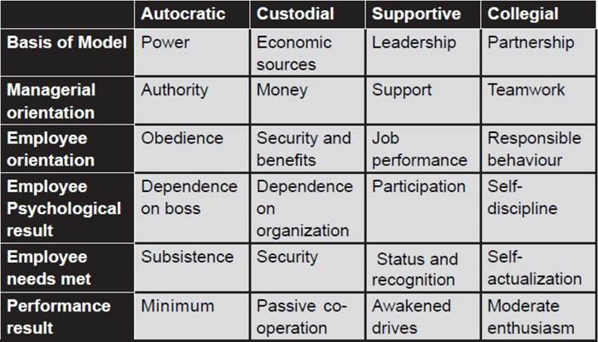
OB Model

Slide 23
Quiz
Basis of Custodial model of OB is-
A. Power
B. Financial security
C. Leadership
D. Team work.

Slide 24
Quiz
Which of the following is not a contributing discipline of OB
a) Anthropology
b) Psychology
c) Physiology
d) Sociology

Slide 25
Quiz
__________ is a Study of Group Behavior
a) Anthropology
b) Psychology
c) physiology
d) sociology

Slide 26
Quiz
___________ is a Study of man, his work and Culture
a) Anthropology
b) Psychology
c) Social psychology
d) sociology

Slide 27
Quiz
OB Helps to understand behavior of human in ___________.
a) work place and Society
b) work place only
c) Society only
d) Department only

